Slide 1



Welcome to
Ashmole
PRIMARY SCHOOL

Slide 2
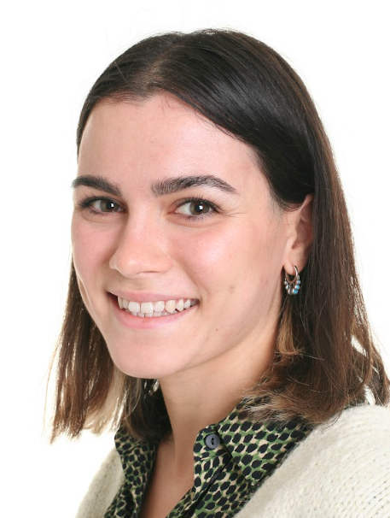
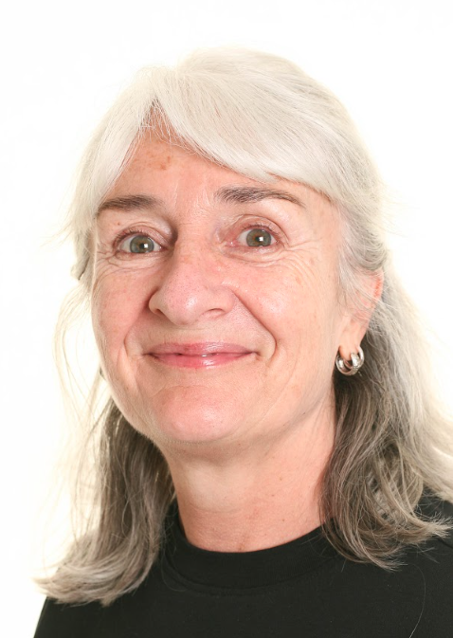
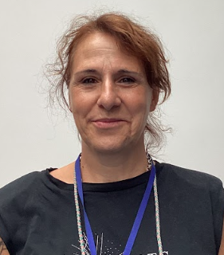
The Year 2 Team
Anne-Marie Daly
Year 2 Class Teacher
English Lead
Oracy Lead
Ann Gurkin
Support Staff
Ms Paoletti
1:1 Support

Slide 3
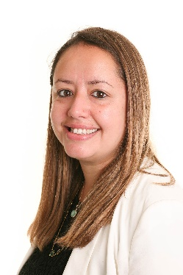
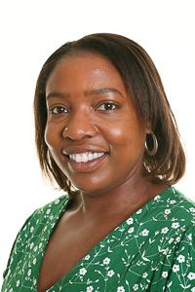
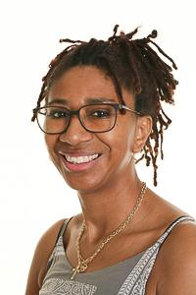
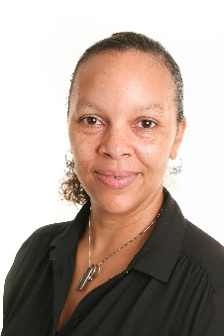

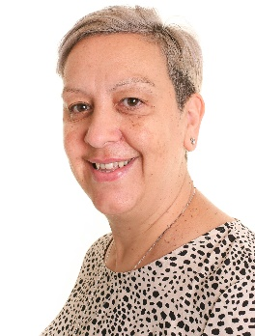
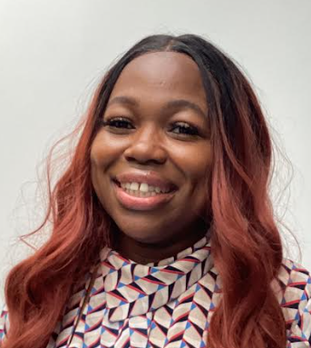
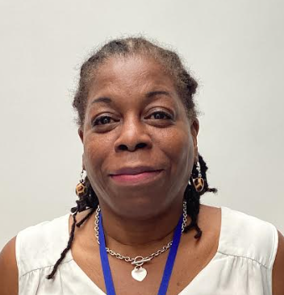
Senior Leaders and Admin Team
Cordelia Cooper
Headteacher
Shelly Griffiths
Deputy Headteacher
Rebecca Coombs
Assistant Head/SENDCO
Heather Henry
EYFS Leader
Keith Chambers
Family Welfare
Julie Caine
School Administrator
Constance Angbadi
School Administrator
Claudia Castillo
School Administrator

Slide 4

Ashmole School Uniform
Clothing
Navy blue sweatshirt, jumper or cardigan with school logo
White shirt or polo shirt (No ties should be worn)
Dark grey or navy-blue trousers (long or short), skirt or pinafore dress
Blue and white gingham check dress
Footwear
Black school shoes must be worn by all pupils (closed toe sandals and pumps are acceptable)
Plain black trainers without logos are allowed but must be completely black including laces, soles and uppers
Shoes with heels or open toes are not allowed
PE Kit
Ashmole PE t-shirt in assigned house team colour with school logo
Black, grey or navy-blue shorts or jogging trousers
Trainers or plimsolls
Jewellery & make-up
Jewellery (other than small stud earrings) must not be worn
Watches are allowed- but no Apple Watches.
Make-up (including nail varnish and lip gloss) is not allowed

Slide 5
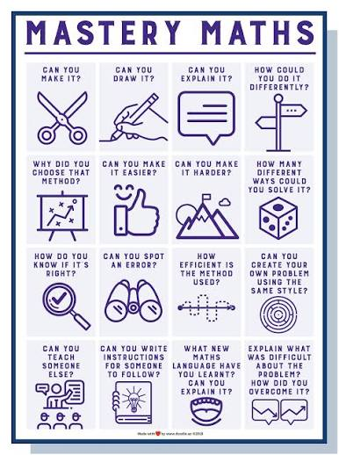
Year 2
The National Curriculum
Mathematics
Children are encouraged to:
Develop a secure understanding of mathematical concepts before moving on.
Explain their thinking using mathematical vocabulary.
Make connections between different areas of mathematics.
Use practical resources and visual representations to support their understanding before moving to abstract methods.
Apply their learning to increasingly complex, unfamiliar and open-ended problems, justifying their reasoning, exploring different strategies and proving whether statements are always, sometimes or never true.

Slide 6


Year 2
The National Curriculum
English
Reading
We encourage children to read every day at school and at home.
Children develop fluency, understanding and a rich vocabulary.
They answer questions, explain their thinking and discuss what they have read.
Children are challenged to make predictions, infer meaning and justify their ideas using evidence from the text.
Phonics
Daily phonics lessons in EYFS and Key Stage 1.
Children learn to read and spell by recognising, blending and segmenting sounds.
Reading books are carefully matched to each child's phonics knowledge.
As children become more confident, they are challenged to apply their phonics skills to read with increasing fluency and understanding.
Writing
Children write for a range of purposes and audiences.
We teach grammar, punctuation and spelling through meaningful writing opportunities.
Children plan, edit and improve their work to produce their best writing.
We challenge children to use ambitious vocabulary, varied sentence structures and write independently with confidence.

Slide 7

Year 2
The National Curriculum
Science
Animals, Plants, Habitats, Materials
Art/ Design and Technology (DT)
Class blanket, Puppets, Fireworks, Bread, Observational drawing, Portraits
Humanities – Geography and History
Seasons, The Great Fire of London, Food, Holidays, Local Heroes
Computing
Physical Education (PE)
Religious Education (RE)
Hinduism, Celebrations, Judaism, Christianity
Personal Social Health Education (PSHE)
Music (MM, Muscianship and IRock)

Slide 8
Year 2 Timetable
8:50 | Gates open for pupils and parents to arrive
9:00 | Register
9:10 | Assembly
9:30 | Mathematics
10:30 | Break
10:45 | Phonics & English
12:00-1:00pm | Lunch
13:00 | Handwriting
13:15 | Science, History, Geography, PSHE, RE, Art, DT or Computing
14:15 | Break
14:30 | Reading
15:15 | Story time
15:30 | Home time

Slide 9

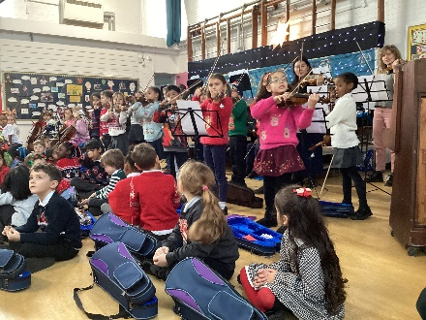
Music in Year 2
Music Masters is an exceptional part of the curriculum at Ashmole because it gives every child the opportunity to learn an instrument, regardless of previous musical experience, and are on site from Tuesday-Friday.
Rather than offering music as an optional extra, it is embedded within school life, ensuring all children can develop confidence, creativity and resilience through high-quality instrumental teaching.

Slide 10


Music in Year 2
This year, and new to Ashmole is ‘iRock’ who will be on site every Monday. Lessons are due to take place from Monday 14th September and if you have signed your child up to learn the guitar, drums, keyboard or vocals, you should have received confirmation of the timing of your child’s lesson.
iRock is not just about the lessons — just like Music Masters, every term culminates in a special performance. Children prepare throughout the term for their concert, and this performance experience plays a key part in developing children's confidence, self-expression and pride in their achievements.

Slide 11
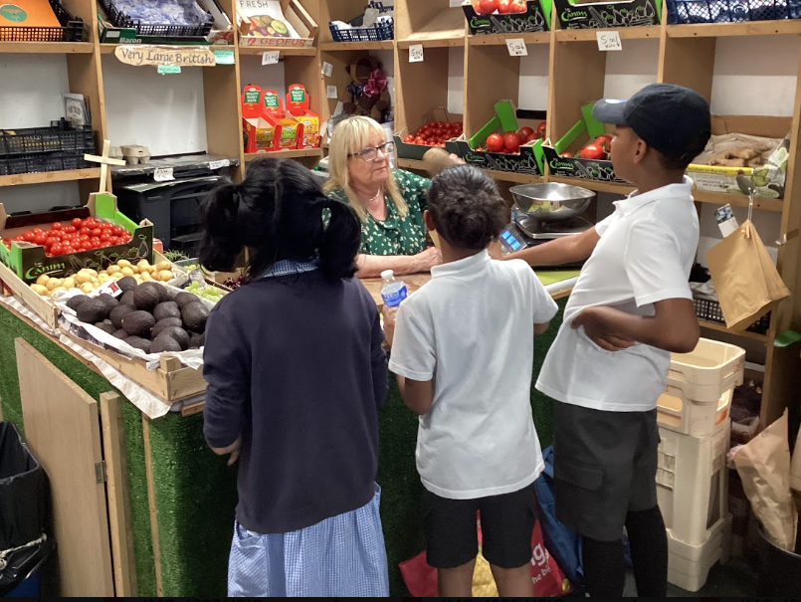
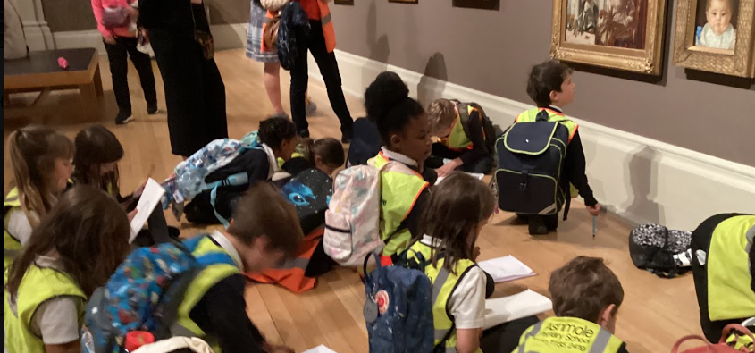
Trips and Enrichment
Educational trips and visits will be used to support your child’s learning in class.
Trips usually take place during school hours and volunteers are normally needed.
We will always inform you of a trip due to take place by letter. Permission slips are only required if a school trip extends beyond school hours.

Slide 12

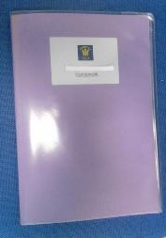
Home Learning
Home learning is sent home each Friday and should be returned the following Wednesday to be marked by the class teacher.
Every week, your child will receive a Maths and SPaG task linked to the weeks learning focus.
There will also be a spelling list of words for your child to learn. They will be assessed on this the following Friday
If you need any support with home learning, please do let us know!
We will speak with you if we notice that home learning is consistently not being completed.

Slide 13

School Attendance
Regular attendance is one of the biggest factors in ensuring children achieve their full potential both academically and socially.
As a reminder:
School starts promptly at 9:00am, with registers taken at 9:05am. Please ensure your child arrives on time each day, ready to learn.
Children arriving after 9:05am must report to the school office and will be marked as late.
Medical appointments should be arranged outside of the school day wherever possible. If your child needs to attend an appointment during school hours, proof of the appointment must be provided. Without this evidence, the absence will be recorded as unauthorised.
Holidays during term time cannot be authorised except in exceptional circumstances, in line with national guidance.

Slide 14
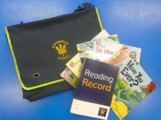

Reading in Year 2
Each child will receive a reading book from the Little Wandle scheme every week. This is matched to their phonic knowledge and they should be able to read it almost fluently.
Your child will read to an adult twice a week in school. Please listen to them read at home every day and write at least one comment in their Reading Record every week.
Books will be changed on a Friday.
Buddy Reading!

Slide 15
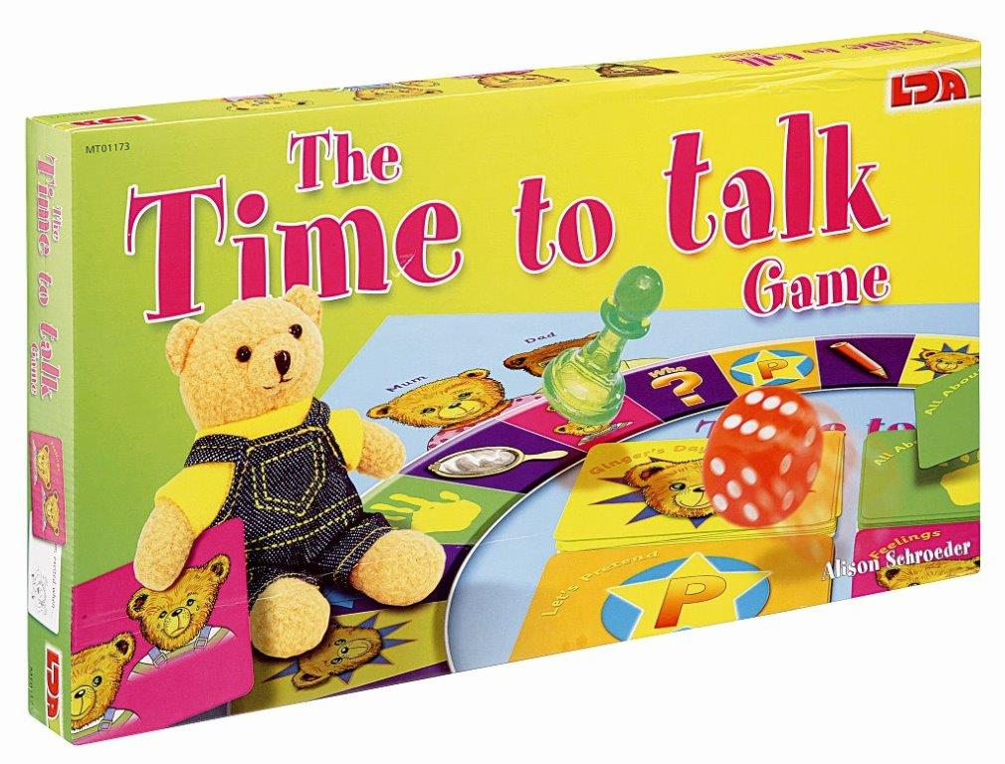


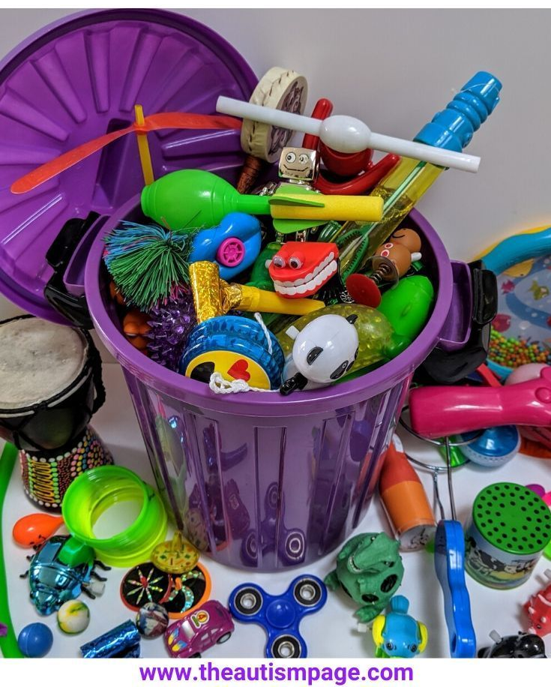
Interventions
Interventions are used to support children in various areas of learning.
Usually delivered to a small group during the school day at a time which is least disruptive to other learning.
Children may be identified for an intervention based on observations or evidence from learning in books or assessments.
Parents will be informed if their child is attending an intervention by the class teacher and through a termly letter.

Slide 16
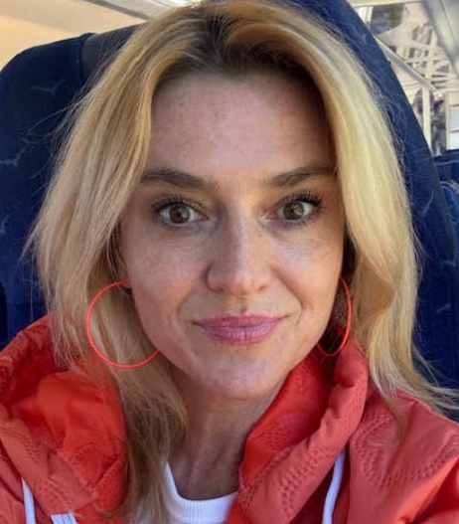
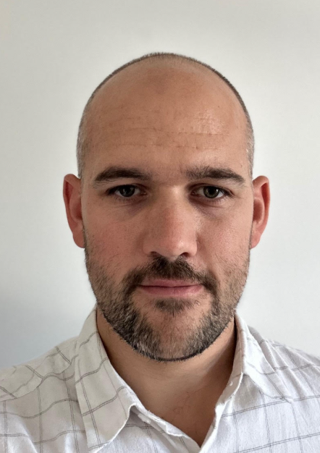
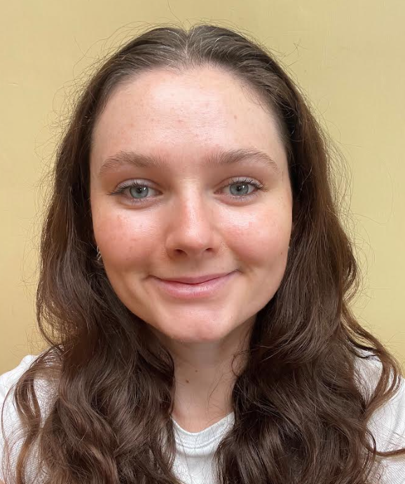
External Professionals
At Ashmole, we work with lots of different professionals who come into school at various times to support staff and pupils.
These professionals are frequent visitors:
Kasia Leszkiewicz - Lambeth Autism Advisory Service
William Bulman - Educational Psychologist
Rosie Metcalfe - Speech and Language therapist
For more information speak to Ms Coombs

Slide 17
Wraparound Care
  Breakfast Club (8:00am – 9:00am)
  Our Breakfast Club provides a welcoming start to the school day. All bookings must be made through the school office and cannot be arranged directly with members of staff. To help us plan staffing, bookings should be made at least two weeks in advance wherever possible.
  YPM After-School Club (3:30pm – 6:00pm)
  Our after-school provision is run by Young People Matter (YPM). Bookings should be made directly through their website: http://www.youngpeoplematter.org/
  After-School Activity Clubs
  We offer a wide range of after-school clubs throughout the year, giving children the opportunity to develop new skills and interests. Information about available clubs and how to sign up will be sent to families by the school, via a Google Form each term.

Slide 18

PSA And School Fundraising
Ashmole are very lucky to have an active and committed PSA (Parent Staff Association) who raise funds for the school to fund a trip later this year, as well as Poetry Day workshops.
Classes may, on occasion, decide to fundraise for individual classes or charitable causes.

Slide 19
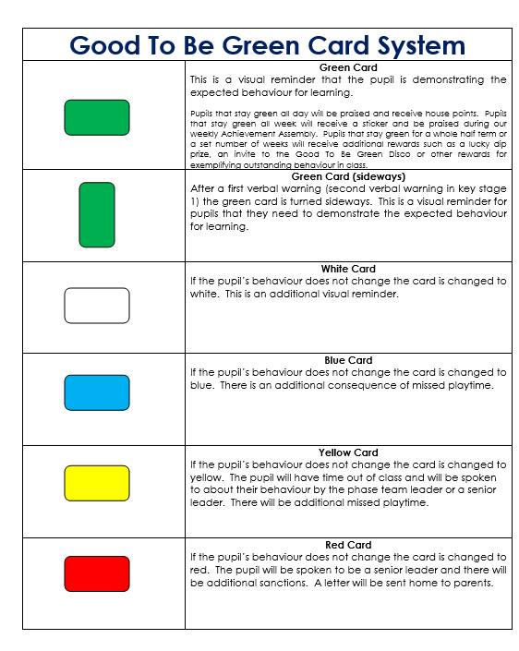
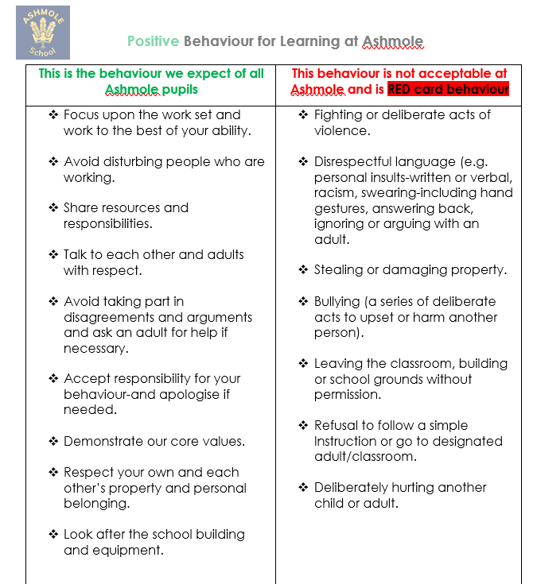
Behaviour in Year 2
If your child receives more than 3 card turns, of any colour, during the course of a half term, you will be informed of this by letter.

Slide 20
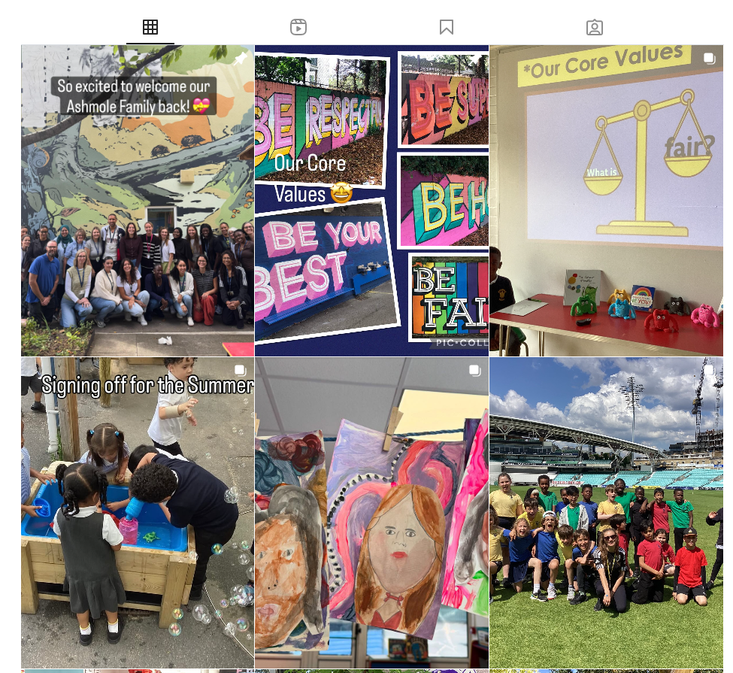
Home and School Communication
Ashmole would like to work together with you at home to help achieve the best for your child. We can communicate with each other through many different channels.
  Letters are sent in both hard copy, email and are on the school website.
  Please check your children’s bags for important letters.
  Reminder Texts are sent for important events.
  Parent/Carer meetings are held 2 times a year
  Opportunities to talk with class teacher at the end of school day.
  If you would like to arrange a meeting, please do so via the school office and make an appointment
  Please check the website and our private Instagram (@AshmolePrimarySchool) regularly for updates of what is happening at Ashmole!

Slide 21


Parent Cafe

Slide 22

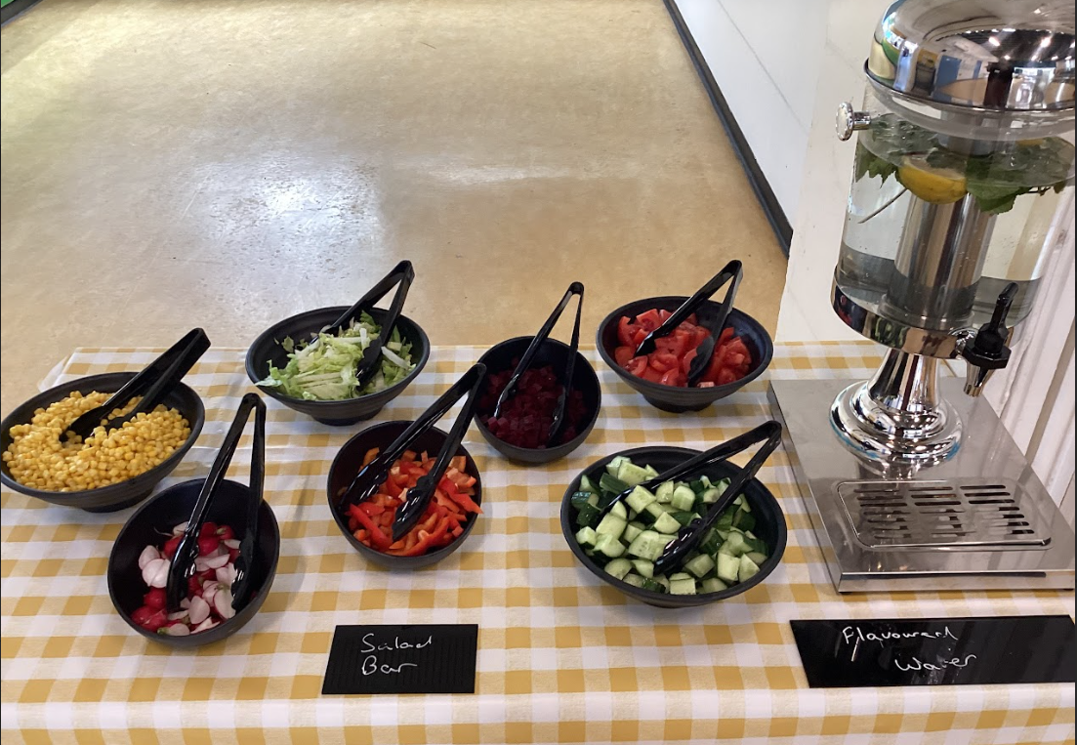
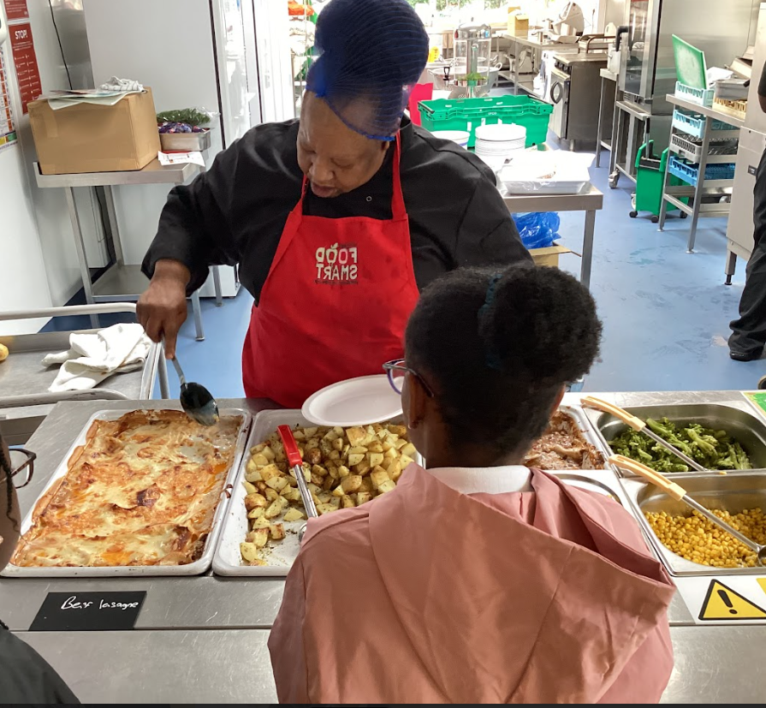

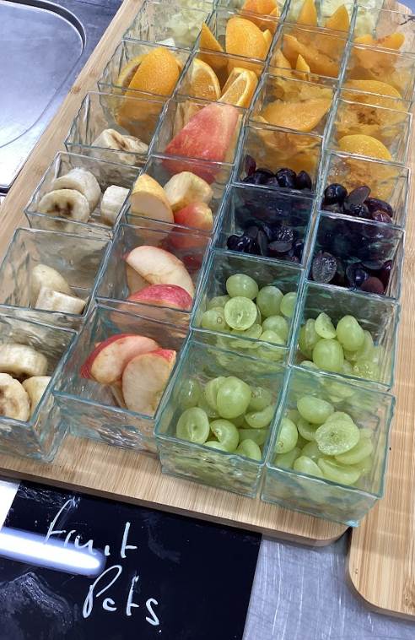
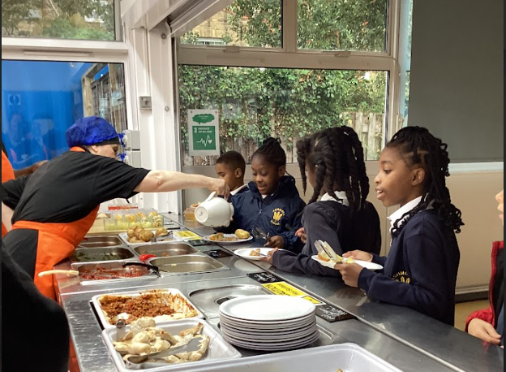
ABM-Ashmole’s School Caterers

Slide 23


